Slide 1
FULL STACK DEVELOPMENT COURSE
DAY 02
IRFANSJAH
irfansjah@gmail.com
081293728732

Slide 2
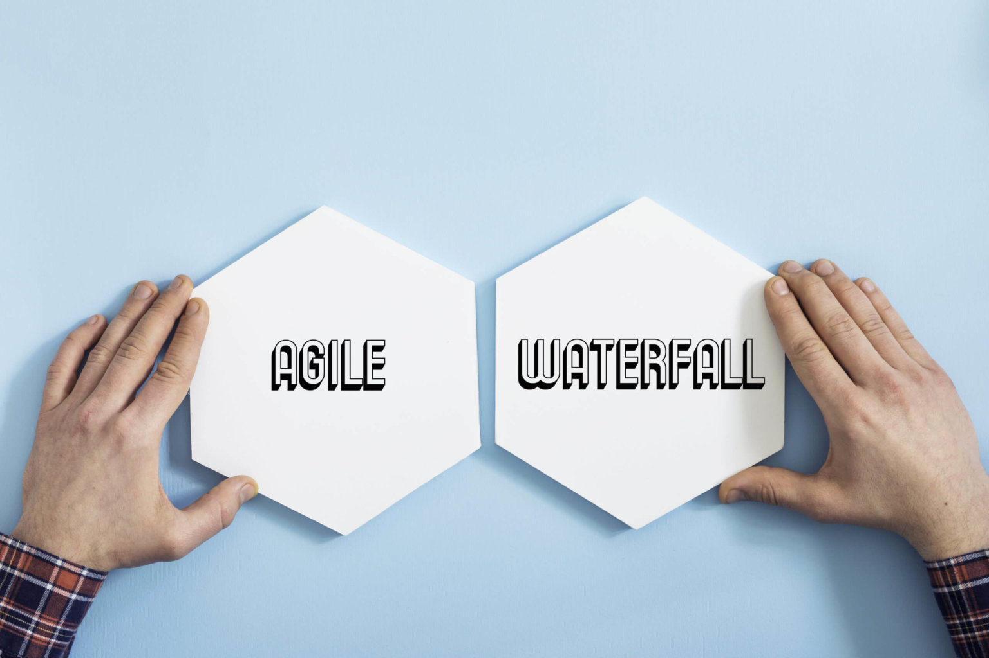
SOFTWARE DEVELOPMENT METHODOLOGY

Slide 3
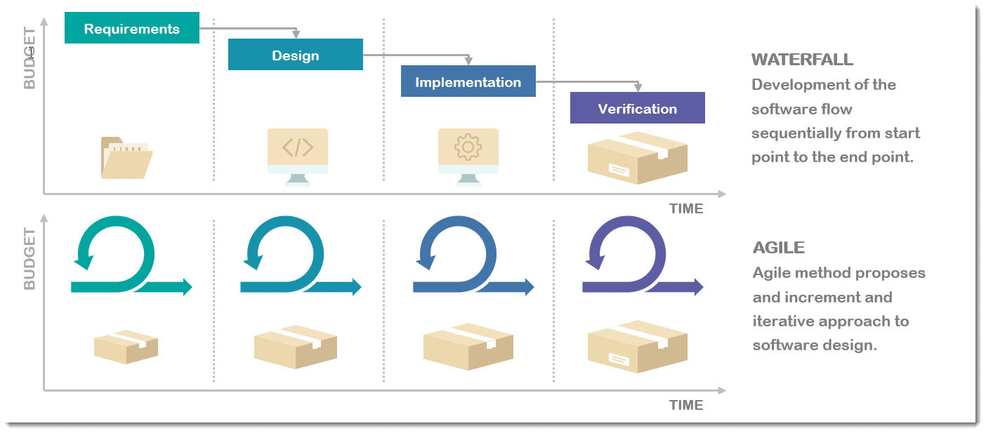
SOFTWARE DEVELOPMENT METHODOLOGY

Slide 4
SOFTWARE DEVELOPMENT METHODOLOGY -WATERFALL
LINEAR SEQUENCIAL LIFE CYCLE MODEL - DEVELOPMENT PROCESS ARE DEVIDED INTO SEVERAL PHASE
SEQUENTIAL
PRODUCT DELIVERABLES AT THE END OF PROCESS
PROJECT SCOPE
SOFTWARE DEVELOPMENT METHODOLOGY

Slide 5
SOFTWARE DEVELOPMENT METHODOLOGY -AGILE
LINEAR SEQUENCIAL LIFE CYCLE MODEL - DEVELOPMENT PROCESS ARE DEVIDED INTO SEVERAL PHASE
INCREMENTAL
DELIVERABLES AT EACH ITERATION
STAKEHOLDER ENGAGEMENT ON ANY ITERATION
SOFTWARE DEVELOPMENT METHODOLOGY

Slide 6
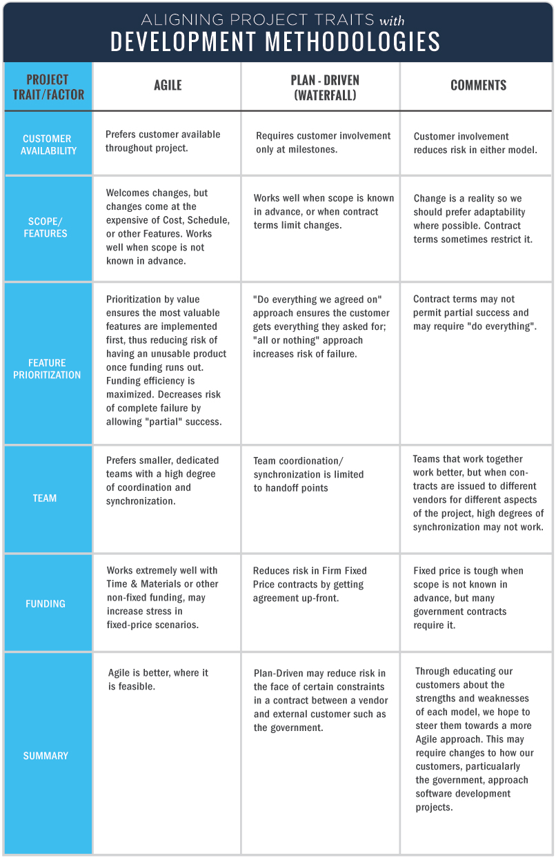
SOFTWARE DEVELOPMENT METHODOLOGY

Slide 7
WHAT IS SCRUM
Scrum is a framework within which people can address complex adaptive problems, while productively and creatively delivering products of the highest possible value.
VALUES
ROLES
EVENTS
ARTIFACTS
SCRUM

Slide 8

VALUES
SCRUM - VALUES

Slide 9
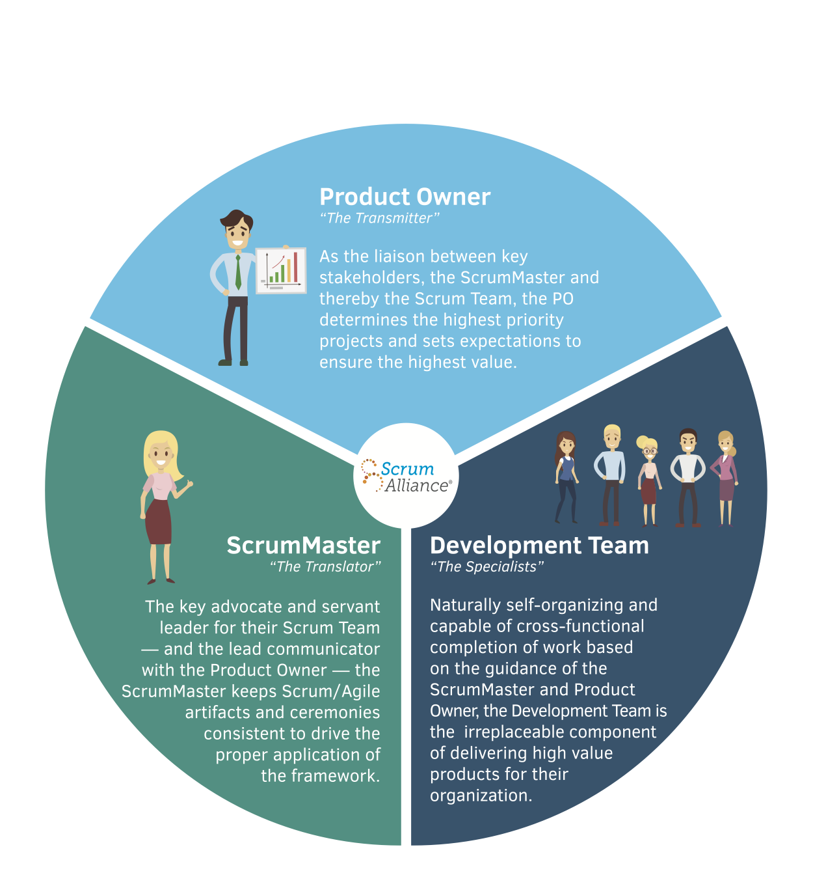
ROLES
SCRUM - ROLES

Slide 10
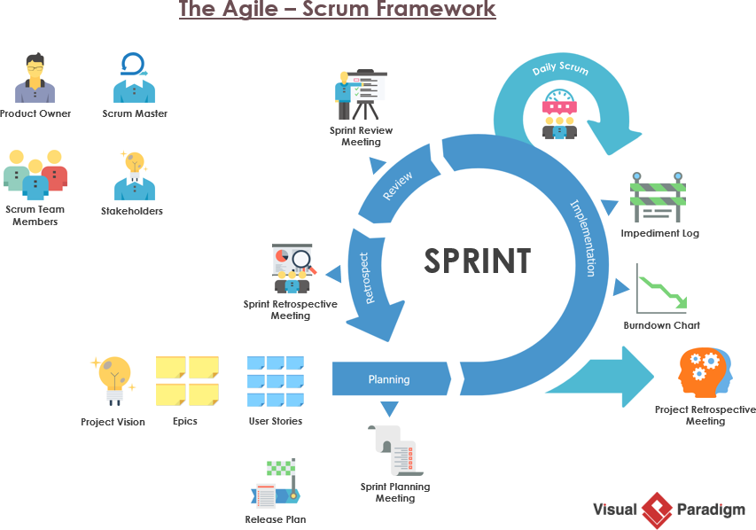
ACTIVITIES
SCRUM - ACTIVITIES

Slide 11
Sprint Planning
This is the event that kick starts each Sprint and is where the Product Owner and Development team discuss which Product Backlog Items (PBI’s) will be included in Sprint. While the Product Owner has the right to prioritise each PBI for potential inclusion in the Sprint, the Development team are encouraged to respond, raise issues and push back where necessary. The Development Team then forecasts how many PBI’s they can deliver in the Sprint, given their knowledge of velocity, resources and any factors which could influence the time and resources they have available.
The outcome of the Sprint Planning Meeting is to get a Sprint Goal and Sprint Backlog that everyone agrees is realistic and achievable.
SCRUM - ACTIVITIES

Slide 12
Daily Scrum
Scrum seeks to efficiently use your time and resources and the Daily Scrum event is no exception. The Daily Scrum is time boxed to 15 minutes. Standing up is not compulsory. However, many teams find this a useful technique to keep the meeting short and to the point.
The Daily Scrum is an opportunity for the Development Team to check in, assess progress towards achieving the Sprint Goal and to review and plan their activities for the next 24 hours.
SCRUM - ACTIVITIES

Slide 13
Sprint Review
Look again at the above principle from the Agile Manifesto — “At regular intervals, the team reflects on how to become more effective, then tunes and adjusts its behaviour accordingly.” That principle alone sums up the reason behind our next two meetings, the Sprint Review and the Sprint Retrospective.
Both events take place at the end of the Sprint. The aim of Agile approaches is not necessary to get everything ‘perfect’ the first time around, but to improve continuously. These events help make that possible.
A Sprint Review usually takes place on the last day of the Sprint and allows you the opportunity to show the “done” Increment to stakeholders (customers, management and anyone else considered relevant and interested). As well as demonstrating working features produced during the Sprint, you’re also after useful feedback that can be incorporated the Product Backlog that may help guide the work for future sprints.
SCRUM - ACTIVITIES

Slide 14
Sprint Retrospective
The final meeting in the Sprint is the Sprint Retrospective. This is when the Scrum team reviews what could be improved for future Sprints and how they should do it. The ethos of Scrum dictates that no matter how good the Scrum team is, there will always be opportunity to improve and the Sprint Retrospective gives the team a dedicated time in which to identify, discuss and plan this. The whole Scrum Team should take part including the Development Team, the Scrum Master and the Product Owner. The meeting should be a collaborative effort, just like the entire Scrum and Agile process.
SCRUM - ACTIVITIES

Slide 15
The Sprint
The Sprint is an event in itself that contains all the work and all the other events that happen during the time boxed period of development.
SCRUM - ACTIVITIES

Slide 16
INCREMENTS
PRODUCT BACKLOGS
User Story
Priority : Story Point
Completion Status
ARTIFACTS
SPRINT BACKLOGS
TASK (what should we do from the story )
Estimation
Actual
Completion Status
Sprint Increment
SCRUM - ARTIFACTS

Slide 17
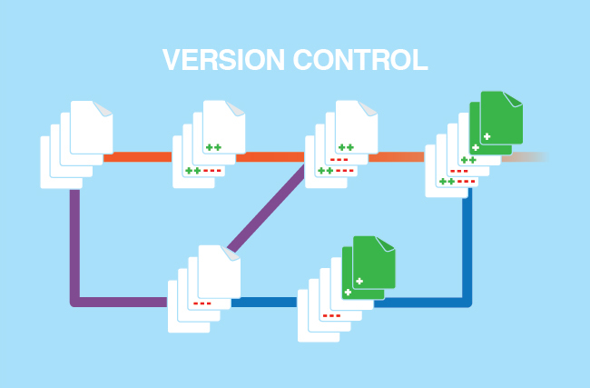
SOURCE CONTROL : SOURCE REPOSITORY A version control system is a special application that stores and manages every revision of your files and code. Many developers and organizations use version control to collaborate on source code, manage releases, and roll back to previous versions when bugs are discovered.
SOURCE CONTROL

Slide 18
DEV CODE
</>
STAGING CODE
</>
PRODUCTION CODE
</>
SOURCE CONTROL - WORKFLOW

Slide 19
CREATING REPOSITORY
git init
WORKING WITH REPOSITORY
ADD ITEM TO REPOSITORY
git add [option]
UPDATE CHANGES
git commit [option] [message]
INSPECTING REPOSITORY
git status
git log
git blame
WORKING BRANCH
git branch
git checkout
SOURCE CONTROL

Slide 20
WORKING WITH REMOTE
REPOSITORY
git remote add [name] [url]
git remote add origin https://github.com/user/repo.git
PUSH AND PULL
git push [name] [branch]
git pull [name] [branch]
SOURCE CONTROL

Slide 21
https://docs.github.com/ https://www.atlassian.com/git/tutorials/ https://rogerdudler.github.io/git-guide/index.id.html https://www.atlassian.com/agile/scrum/
REFERENCE

